Slide 1
Programming
Happiness
Things a Developer Experience Engineer rarely talks about

Slide 2
You’ll never believe this one crazy tip that will make all developers happier and more productive!
… wait, how do I get ad-revenue from a slide show?

Slide 3
Donald Knuth
Things a computer Scientist Rarely Talks About
- Lectures @ MIT in 1999
- Book followed in 2001
- He spoke about religion, I won’t.
- I’ll talk about happiness
Geoffrey J. Teale / CODEX 2021

Slide 4
Oh noes! I’ve come to a hippy-dippy-fun-in-the-sun talk about crystals and Aromatherapy. What the heck? I thought this was supposed to be about programming java, agile or something else like that. :-(

Slide 5
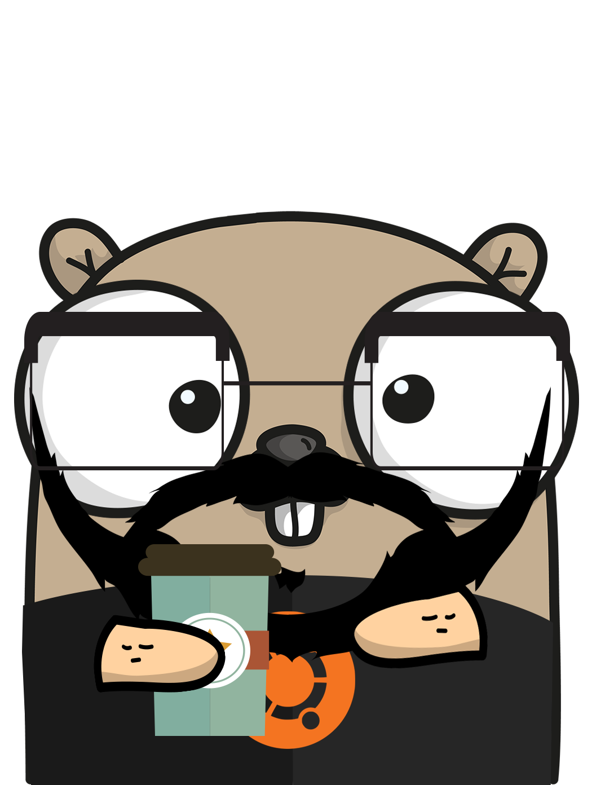
Why do you care?
I’m a developer Experience Engineer
Developer eXperience Engineering is:
"An engineering effort using a holistic product design approach to refine a software developer’s experience with a product.”
Programmers are people too!
Geoffrey Teale / CODEX 2021

Slide 6
Its good business
"Become a Nurse. Your Country Needs You, 1942" by kitchener.lord is licensed under CC BY-NC-ND 2.0
I’m un-hippily fact driven
Happy developers are productive developers
Developers are hard to find and easy to lose
Understanding how you tick helps me do my job, and you do yours
I promise practical solutions
Geoffrey Teale / CODEX 2021

Slide 7

Why Happiness?
Developer Care
A DevX engineer can code, document, design, test and teach to make product experience great.
What else can we do?
If only there were a venue where we could talk to engineers more generally?
Geoffrey Teale / CODEX 2021

Slide 8

Let’s Start at the very beginning
"Vintage Disney Mary Poppins Plate by Sun Valley Melmac" by GranniesKitchen is licensed under CC BY 2.0
… a very good place to start.

Slide 9
The nature of happiness
Personal Observations
Happiness is a fleeting, ephemeral thing
Mostly I am content:
I recognise happiness as a distinct state
Contentment is the absence of unhappiness
e.g. money is only a factor when it’s missing ;-)
Geoffrey Teale / CODEX 2021

Slide 10
When did Software Engineering make you happy?
Personal observations
Rewarding:
When a task is completed
When I do something I’ve never done before
When I get recognition from my peers
When I see others benefitting from my work
Sensational:
Those days when the code is just flowing out of me
GEOFFREY TEALE / CODEX 2021

Slide 11
When did software engineering make you unhappy?
Personal Observation
Obstructive:
When I couldn’t “get into” a problem
When I am unable to concentrate long enough
Dull:
When things are too slow
When it is too easy, or too repetitive
Stressful:
When colleagues are too competitive
When I feel ignored or powerless
When I lack clear goals
Geoffrey Teale / CoDEX 2021

Slide 12
Depression
I am lucky not to have depression
Depression is not a mood fluctuation or simple emotional response.
This talk doesn’t address depression - I don’t have any answers - but talking about it is important.
Know that you are not alone.
The WHO estimate 5% of adults suffer from depression globally.
Depression in Germany affects 17% of people (Robert Koch Institute)
More people than the combined population of Berlin, Hamburg, Munich, Cologne, Frankfurt am Main, Stuttgart, Düsseldorf, Dortmund, Essen, Leipzig, Bremen, Dresden and Hanover.
Geoffrey Teale / CODEX 2021

Slide 13
Lets EXPLORE our brains

Slide 14
DOPAMINE REWARD SYSTEM

Slide 15
Completion and Reward
Dopamine
We receive focused waves of dopamine in the frontal-cortex when we achieve goals or satisfy needs.
Once we associate tasks with a potential reward we produce anticipatory dopamine.
More important for “incentive salience” than “hedonic impact”[1]
Geoffrey Teale / CODEX 2021
"Dopamine" by intropin is licensed under CC BY-NC 2.0

Slide 16
Completion and reward
Dopamine
We produce more dopamine when:
- we are in control of the outcome (<100% chance)
- when we cooperate with others or place social needs first.
Bigger rewards are required to motivate us to do more work
GEOFFREY TEALE / CODEX 2021

Slide 17
Autonomy
Dopamine
Autonomy is the single most important factor in workplace happiness. [6][7][8][9]
Autonomy is important to our dopamine rewards system.
Not team level autonomy (it doesn’t matter who you have to justify yourself to).
Not democracy
Autonomy means having clear goals set, but having the trust of *everyone* to reach the solution alone.
Geoffrey Teale / CODEX 2021

Slide 18
Boosting Dopamine
Stuff anyone Can do
People with higher levels are happier, and more motivated!
- Sleep properly [2]
- Listen to music (even at work!) [3]
- Get outside in the sunshine
- Exercise, meditate, garden, play with a pet
- Have human contact
Geoffrey Teale / CODeX 2021

Slide 19
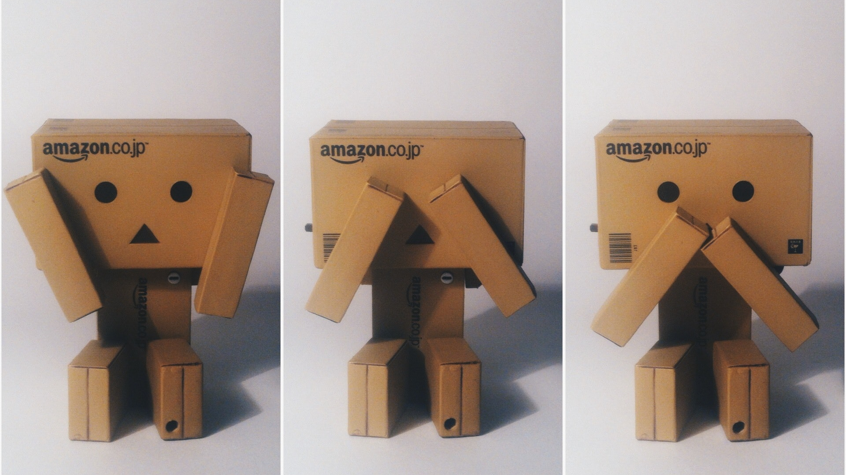
Aside
Programming isn’t like using human language

Slide 20
Code isn’t Language
ITs a puzzle
We barely activate areas of the brain used for language when reading/writing code. [4]
It’s more like doing crosswords or sudoku.
This is probably why rubber ducking works!
Geoffrey TEALE / CODEX 2021

Slide 21
Programming Changes you
[possibly]
Continuous stimulation via programming might even lead to specialised structure developing in the brain.
This might take 30 or 40 years [5]
Geoffrey Teale / CODEX 2021

Slide 22
Flow

Slide 23
When the code just flows
FLOW
Csikszentmihalyi describes eight characteristics of flow: [10]
- Complete concentration on the task
- Clarity of goals and reward in mind and immediate feedback.
- Transformation of time (speeding up/slowing down)
- The experience is intrinsically rewarding
- Effortlessness and ease.
- There is a balance between challenge and skills
- Actions and awareness are merged, losing self-conscious rumination
- There is a feeling of control over the task
Geoffrey Teale / CODEX 2021

Slide 24
Rare, but Hyperproductive
Flow
You need just the right conditions.
It feels *great*
It’s extremely productive.
The myth of the 10x programmer probably exists because “special” people are allowed the space.
Geoffrey Teale / CODEX 2021

Slide 25
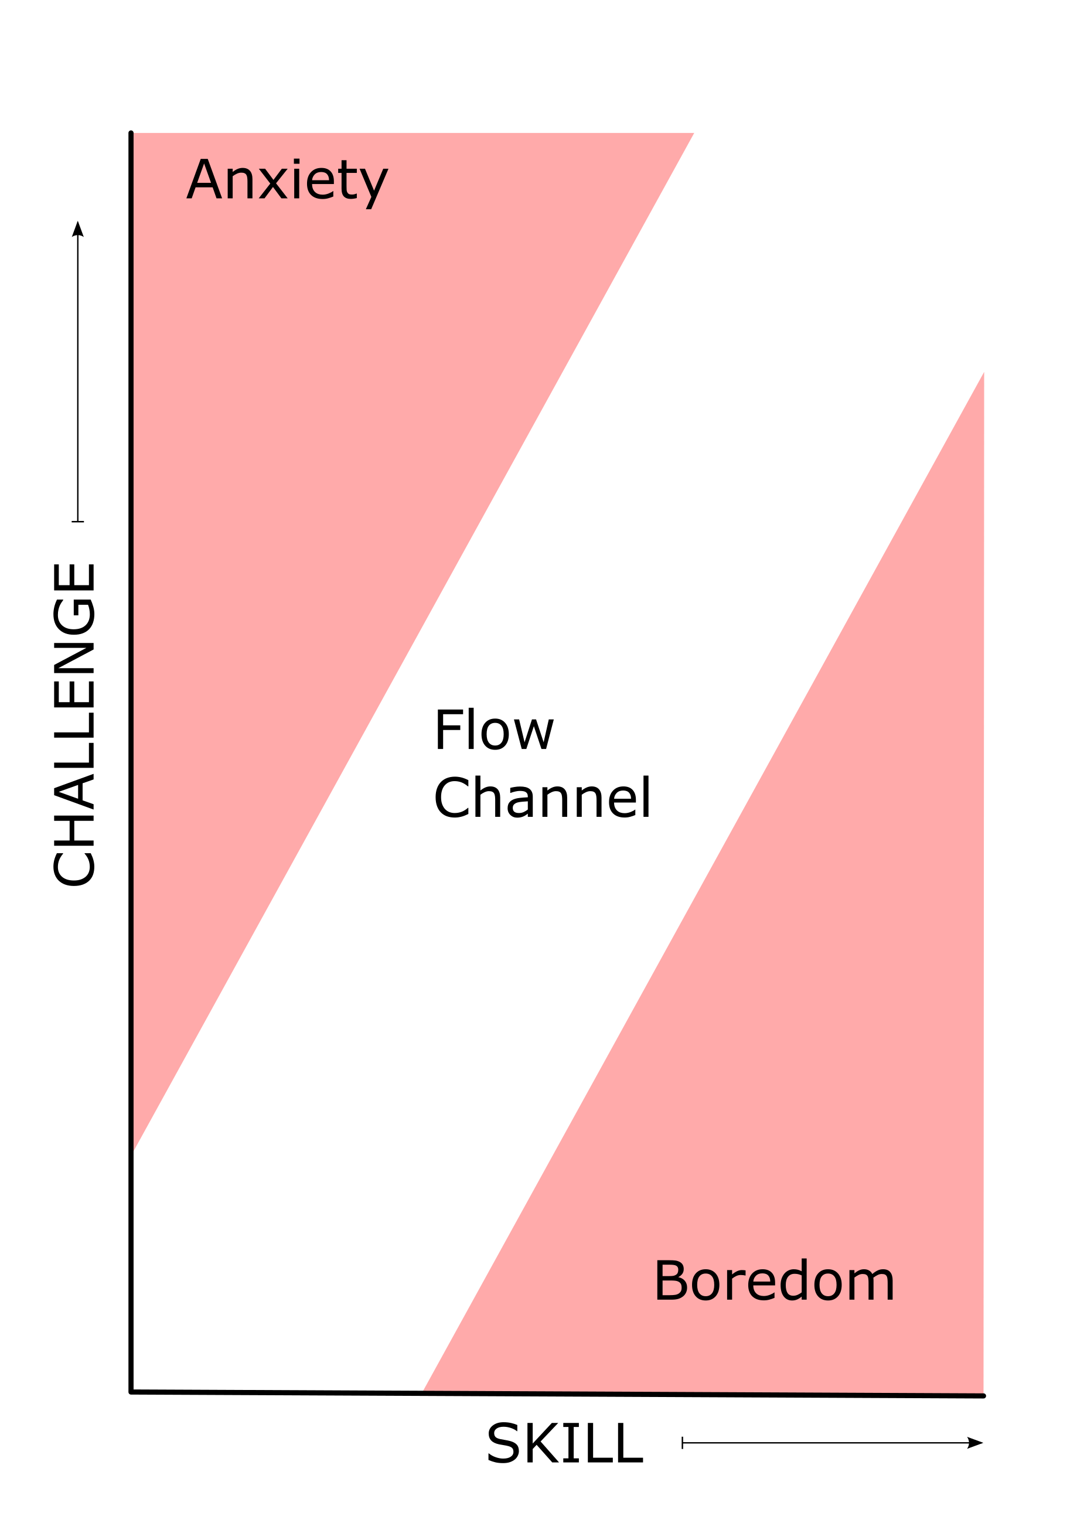
Role of Challenge
FLOW
Vygotsky’s zone of proximal development [11]
You only achieve flow within the “flow channel”.
You might have to overcome your brains instinct to avoid challenge.
GEOFFREY TEALE / CODEX 2021

Slide 26
Autonomy Again
Flow
Autonomy is a product of trust:
Trust people to work alone.
Trust your colleagues to get it right without you.
Trust juniors to do things they’ve never done.
Don’t make yourself a part of every decision.
Geoffrey Teale / CODEX 2021

Slide 27
Uninterrupted FOCUS
Flow
REQUIRES TIGHT FOCUS, CLEARLY DEFINED GOALS
FLOW STATES REQUIRE REDUCED PREFRONTAL-CORTEX ACTIVITY - “HYPOFRONTALITY” ->
NO HUMAN INTERACTION
GEOFFREY TEALE / CODEX 2021

Slide 28
Habits of a happy programming team

Slide 29
What do we need to achieve?
Key factors in our happiness
Make space for flow:
- Create psychological safety
- Long blocks of focused time
Set the right challenge level
Optimise our working life to trigger the dopamine reward system
- quick, clear wins
- social
- autonomous
Remove blockers
Geoffrey TEALE / CODEX 2021

Slide 30
Have human contact,
but not all the time.

Slide 31
Plan to do possible flow work when you’re alone

Slide 32
Plan what needs to be done,
but leave the “how” for individuals.*
Autonomy is not democracy.
* Bonus: shorter planning meetings!

Slide 33
Favour CI/CD over review
(Psychological Safety)

Slide 34
Make small tasks with clearly
defined completion states
(Yay AGILE, YAY TDD)

Slide 35
Optimise processes for short feedback loops

Slide 36
Fix bugs in your open source dependencies.

Slide 37
Don’t be the “go-to” person.
Write the “go-to” document.
See also:
Software engineers don't scale ... or how I learned to stop worrying and love commenting my code.

Slide 38
RFCs not meetings.
Asynchronous work makes space for flow.

Slide 39
Delegate, automate or “Gamify” things that are not challenging enough

Slide 40
Use pairing/mobbing to get past things that are too challenging

Slide 41
Don’t do Blog-post driven development
Try THINkING (it’s fun!)

Slide 42
TRUST your colleagues

Slide 43
Remember:
Clear goals
+ trust
+ space
= happiness.

Slide 44
That one crazy tip….

Slide 45
STOP

Slide 46
IT

Slide 47
WITH

Slide 48
The

Slide 49
DAMNED

Slide 50
MEETINGS

Slide 51
Already

Slide 52
FIN

Slide 53
Citations
Just the facts m’am
[1] Berridge KC, Robinson TE. What is the role of dopamine in reward: hedonic impact, reward learning, or incentive salience? Brain Res Brain Res Rev. 1998 Dec;28(3):309-69. doi: 10.1016/s0165-0173(98)00019-8. PMID: 9858756.
[2] https://www.ncbi.nlm.nih.gov/pubmed/29073398
[3] https://www.ncbi.nlm.nih.gov/pubmed/21217764
[4] https://elifesciences.org/articles/58906
[5] https://news.mit.edu/2020/brain-reading-computer-code-1215
Geoffrey Teale / CODEX 2021

Slide 54
Citations
Just The FACTS M’AM
[6] Legault, Lisa. (2016). The Need for Autonomy. Encyclopedia of Personality and Individual Differences. 10.1007/978-3-319-28099-8_1120-1.
[7] Niemiec, C. P., & Ryan, R. M. (2013). What makes for a life well lived? Autonomy and its relation to full func- tioning and organismic wellness. In The Oxford hand- book of happiness (pp. 214–226). Oxford: Oxford University Press
[8] Moller, A. C., & Deci, E. L. (2010). Interpersonal control, dehumanization, and violence: A self-determination theory perspective. Group Processes & Intergroup Relations, 13, 41 –53
[9] Spreitzer, Gretchen (2008), Taking Stock: A Review of More Than Twenty Years of Research on Empowerment at Work
Geoffrey Teale / CODEX 2021

Slide 55
Citations
Just the facts M’am
[10] Csikszentmihalyi, Mihaly. (1990). Flow: The Psychology of Optimal Experience.
[11] Vygotsky, L. S. (1978). Mind in society: The development of higher psychological processes. Cambridge, MA: Harvard University Press.
GEOFFREY TEALE / CODEX 2021

Slide 56
CREDITS
Images
All images in this presentation are either in the public domain, or have creative commons license information overlaid on them.
One image (the statue of a man standing on a golden ball) was taken by me in Salzburg, Austria in 2011.
Geoffrey TEALE / CODEX 2021.

